Slide 1

Menu Tingz
Testing Report
Group: K.O.D Inc
Members: Ottor Mills
Kenneth Anglin
Nicoy Smith
David Thomas

Slide 2
Software Testing
Software testing is a crucial aspect of the software development life cycle. It is said that no software is error free. Software testing reveals any vulnerabilities in an application’s source code. Hackers make some of the best software testers.

Slide 3
Tools Used
Calabash Testing Framework
JavaScript

Slide 4
What is Menu Tingz
Menu Tingz is an android application made by BajanTech which allows users view and order dishes from various restaurants listed within the application.

Slide 5
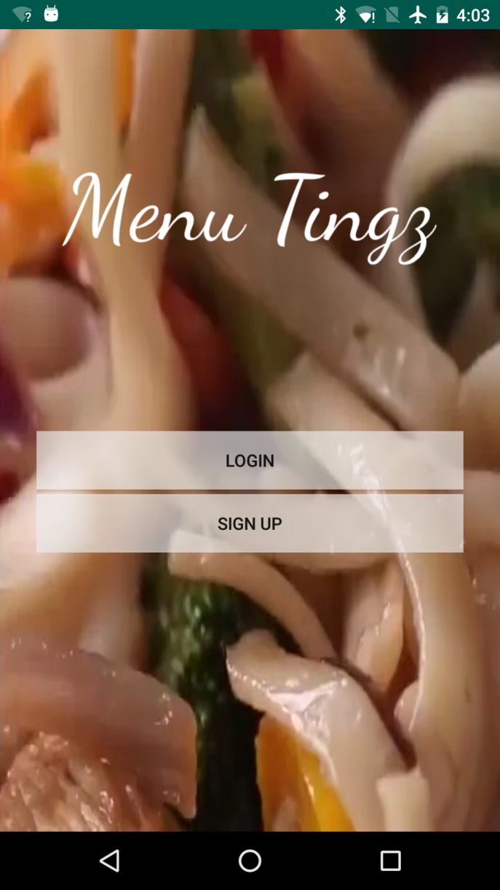
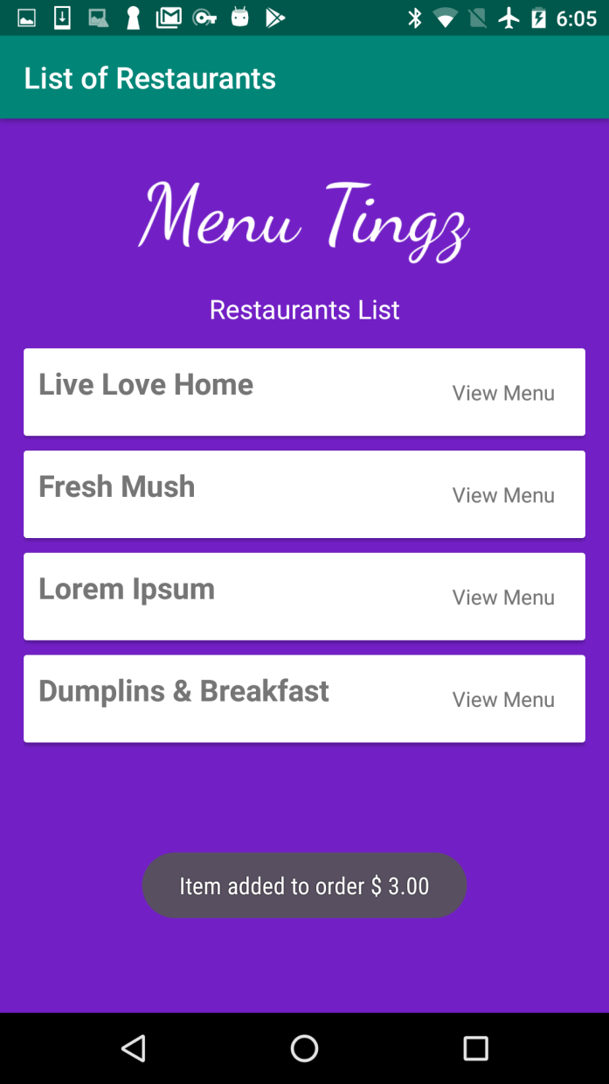
User Interface

Slide 6
Use Cases
Adding dishes to tray
Removing dishes from tray
Placing orders
Creating Account
Logging In

Slide 7
Use Cases (Contd.)
The Menu Tingz app can successfully carry out each use case. After logging in the app has well defined event flows. (Not much testing required)
Small Domain

Slide 8
Use Cases (Contd.)
On the other hand, the login and sign up forms is vulnerable to malformed inputs and as such automation is necessary.
Large Domain

Slide 9
Methodology
Test: Black Box Vulnerability Testing
Method: Bruteforcing
Testing Domain: Very Large
Order of Growth: Very Large
Target: Login and Sign Up Forms
Multiple threads with headless emulators were considered greatly to improve runtime.

Slide 10
Vulnerability Testing (Contd.)
This test consisted of a feature file in combination with a JavaScript program. The feature file acted as a template and the JavaScript program made changes to this file to carry out each test case. Once changes were made to the file it was executed using a subprocess.

Slide 11
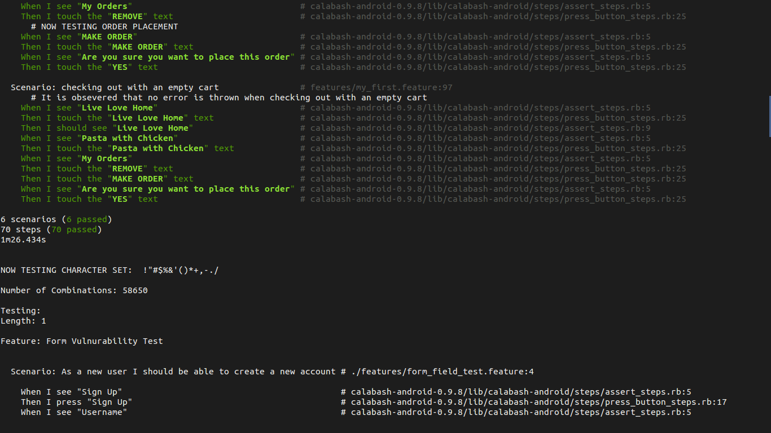
Sample Output

Slide 12
Demonstration
(Attachment file not found)

Slide 13
Noteworthy Discoveries
App allows for weak usernames and passwords
No max length of the form fields
Screens aren’t properly stacked
Sqlite database appears to be vulnerable to injection attack
No measure to prevent brute forcing

Slide 14
Application Improvements
Setting a minimum length for passwords and usernames
Setting a max length of the form fields
Fix the navigation stack & logout buttons
Add slashes to SQL queries to protect against SQL injection attacks
Implement captcha to prevent bruteforcing

Slide 15
Alternative App Testing Tools
1. Espresso
2. Flutter Testing Package
3. WebdriverIO + Appium

Slide 16
The End
Any Questions?

